Slide 1
Data Profiling
TALEND OPENSTUDIO FOR DATA QUALITY

Slide 2
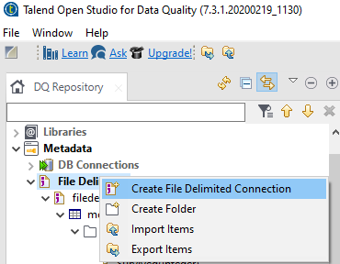
Stepwise Process for data profiling using talend data quality:
Step1: Creating Connections to data sources
Connecting to a file for column analysis:

Slide 3
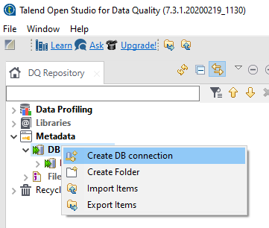
Step2: Creating Connections to data sources:
Connecting to a MYSQL Database for column analysis:

Slide 4
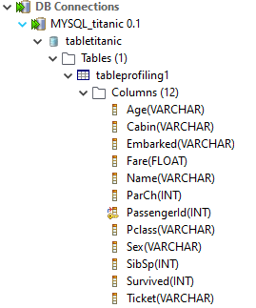
After fetching data from MYSQL:

Slide 5
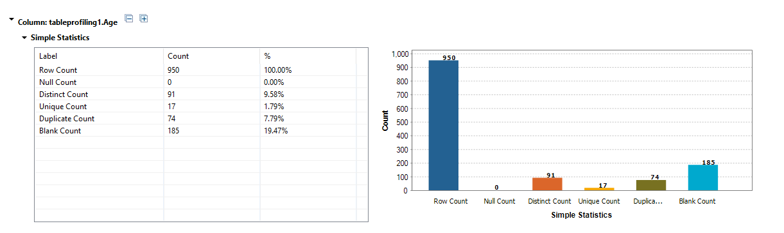
Basic column analysis
Observation based on data quality dimensions:
Counts of all rows is seen so to conclude, there are no empty rows in our titanic dataset,
Many blank values on the column Age has been found so those which shows incompleteness
AGE COLUMN

Slide 6
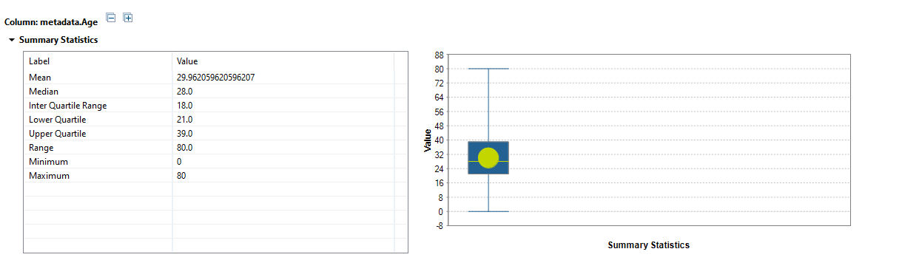
Summary statistics analysis
Observation:
Mean ,median values are calculated which will be useful for cleaning missing values to achieve completeness.
It is valid from the observation.
AGE COLUMN

Slide 7
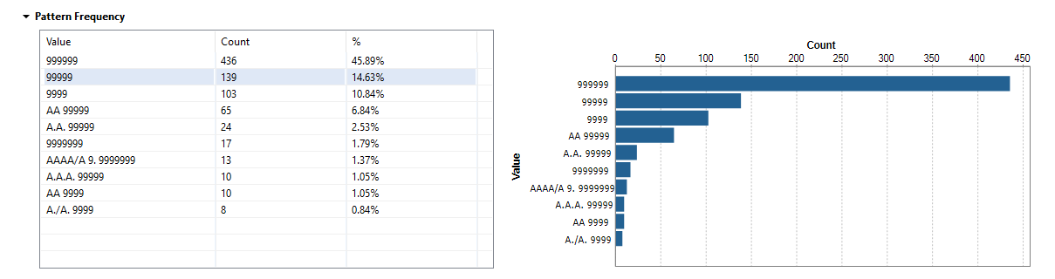
Column analysis: Data type and patterns
Observation:
Different data formats like alpha numeric, integers, alpha-numeric with / and . are seen on the ticket column which has lack of conformity.
TICKET COLUMN

Slide 8
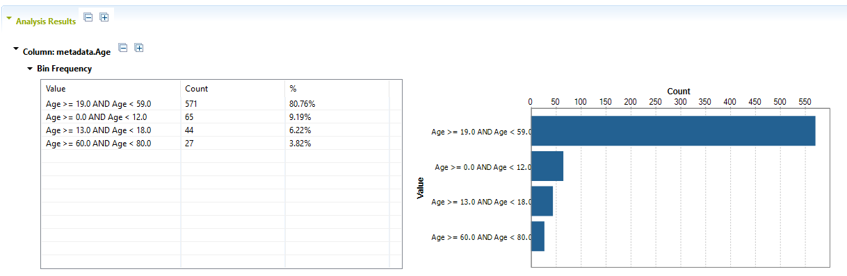
Discrete data analysis
Observation:
The bin frequency ranges has been configured for categorising ages based on child, adolescence, adults, senior adults.
Adults has been more in count on the age column and child comes second.
AGE COLUMN

Slide 9
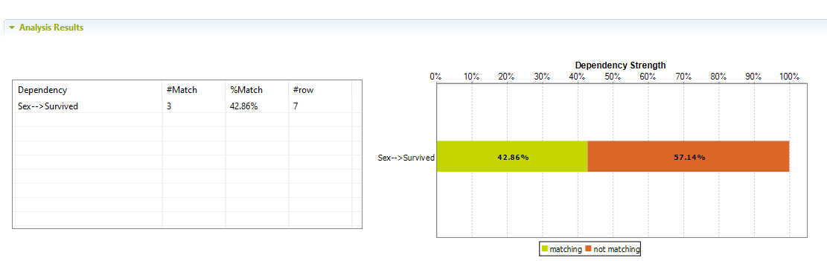
Functional dependency analysis:
Observation:
Survived people has been 42.46% on survived column based on gender column
Sex and Survived

Slide 10
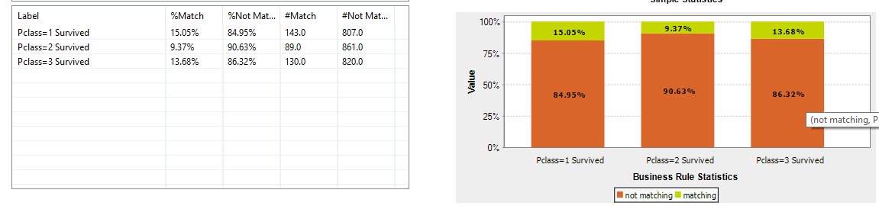
Business Rule Analysis
Observation:
Survived people based on the passenger class 1 has been seen
Survived people based on the passenger class 2 has been seen.
Survived people based on the passenger class 3 has been seen.

Slide 11
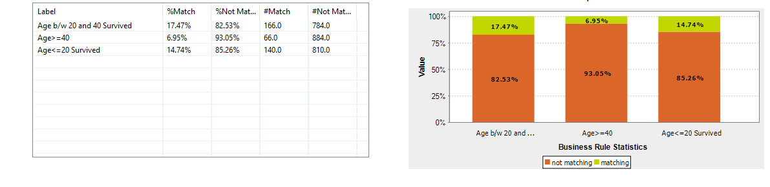
Business Rule Analysis
Observation:
Survived people based on the age greater than or equal to 40 has been seen
Survived people based on the age b/w 20 and 40 has been seen.
Survived people based on the age less than or equal to 20 has been seen.

